Slide 1
Project Title
E – commerce Analysis project
Name: Pankaj Kumar
Date: 02/09/2026

Slide 2
BUSINESS CONTEXT
The company is an e-commerce business operating through an online website.
The company collects data from website sessions, pageviews, orders, products, and refunds.
The company wants to move from basic reporting to data-driven decision-making.
The CEO, Cindy, is preparing the company for its next round of funding.
Management needs dashboards to regularly monitor business performance and KPIs.
The website team needs insights into customer visits, sessions, devices, and browsing behaviour.
The marketing team needs to evaluate traffic sources, campaigns, and marketing performance.
The analytics team is expected to provide descriptive, diagnostic, and prescriptive analytics to support business growth and strategic decisions.

Slide 3
PROBLEM STATEMENT
Revenue Growth: The company needs to identify revenue and order trends to understand growth patterns and periods of decline.
Website Engagement: The website team needs to identify browsing and engagement patterns using sessions, pageviews, devices, and page URLs.
Marketing Performance: The marketing team needs to determine which UTM sources, campaigns, and content generate the highest traffic, orders, and revenue.
Product Performance: The company needs to identify top-performing and underperforming products based on sales, revenue, COGS, and profitability.
New Product Analysis: Management needs to evaluate whether newly introduced products are achieving expected sales and revenue performance.
Refund Analysis: The company needs to identify products and periods with high refund amounts and understand their impact on profitability.

Slide 4
TECHNOLOGY STACK
Python: Data cleaning, EDA, predictive analytics; Flexible for data analysis and machine learning.
SQL: KPI calculations & stakeholder analysis; Useful for revenue, orders, customers, growth, rankings, and segmentation.
Power BI: Stakeholder dashboards; Creates interactive dashboards for CEO, Website Manager, and Marketing Director.
Jupyter Notebook: Analysis & experimentation; Provides an interactive environment for EDA, modelling, and documentation.
SQL Server: Data storage & business analysis; Efficiently query large datasets and calculate business KPIs.
Streamlit /GitHub: Version control & project documentation; Stores project code, documentation, and project versions.

Slide 5
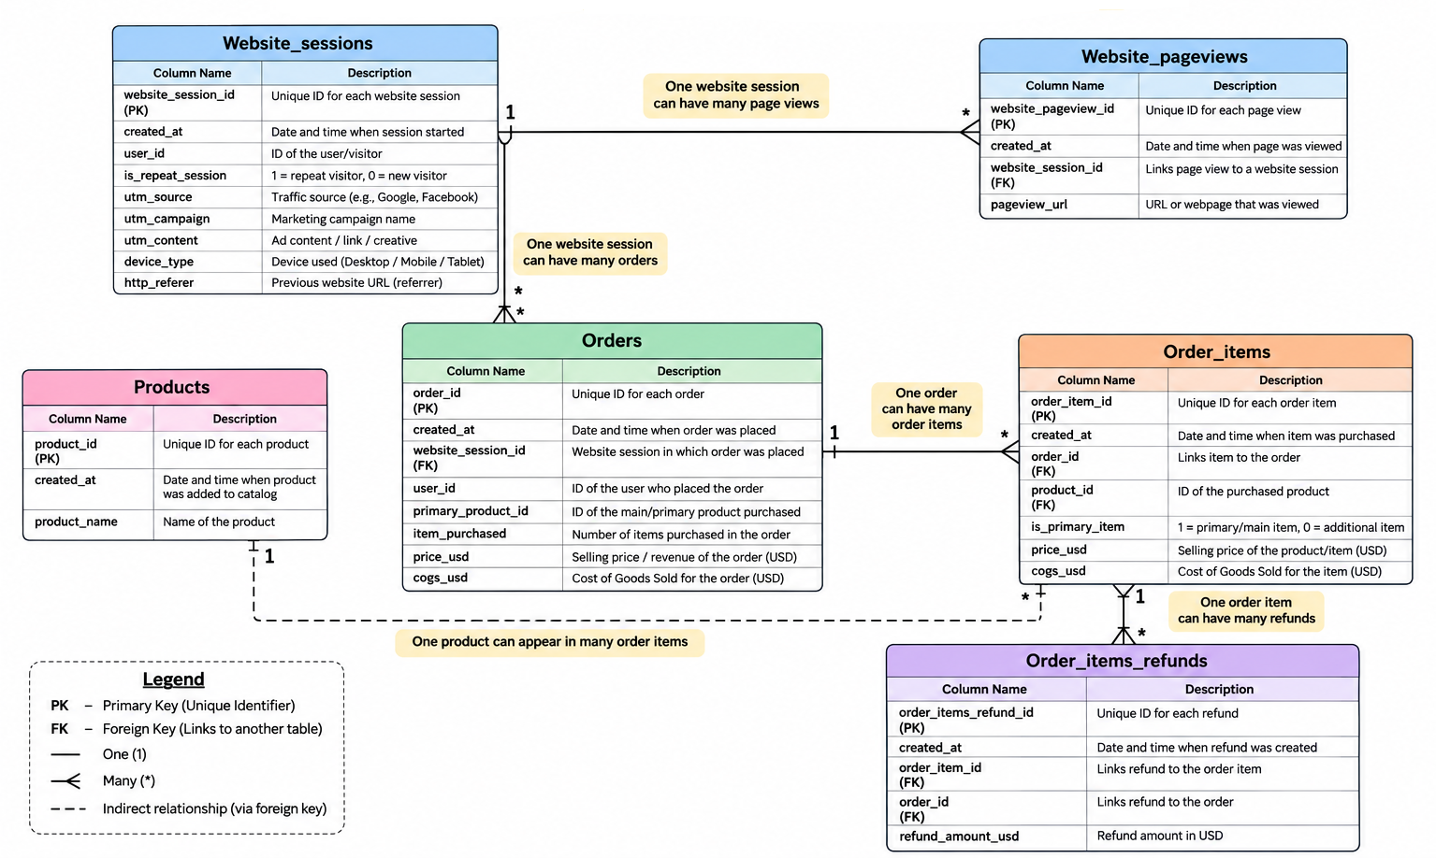
ER DIAGRAM

Slide 6
ASSUMPTIONS
Unique Identifiers: It is assumed that order_id, order_item_id, user_id, product_id, and website_session_id are unique identifiers within their respective tables.
Order & Product Relationship: It is assumed that one order can contain multiple order items/products, and the order_items table provides product-level details for each order.
Revenue & COGS: It is assumed that price_usd represents the selling price/revenue and cogs_usd represents the Cost of Goods Sold. Gross profit is calculated as Revenue − COGS.
Customer & Session Behaviour: It is assumed that user_id represents a unique customer who can have multiple website sessions and multiple orders, while website_session_id represents a unique website session containing multiple pageviews.
Marketing Attribution: It is assumed that utm_source, utm_campaign, and utm_content correctly identify the marketing source, campaign, and content responsible for generating website traffic.
New Product & Predictive Analysis: It is assumed that products.created_at represents the product launch date and that sufficient historical data is available to analyze new product performance, business trends, and future business outcomes.

Slide 7
DATA AUDITING
Missing/null values: Prevents incomplete KPIs and analysis
Duplicate IDs/records: Prevents double-counting
Correct values and data types: Ensures reliable calculations
Values agree across tables: Ensures reliable relationships
Foreign keys have matching records: Prevents orphan records
Price, COGS, refunds: Critical for revenue/profit analysis
Logical business conditions: Ensures data reflects real business behaviour
Unusual values: Helps identify errors or exceptional transactions

Slide 8
DESCRIPTIVE ANALYSIS
Revenue & Sales Performance Analysis:- Analyze total revenue, number of orders, units sold, COGS, and gross profit to understand overall business performance.
Website Traffic & Session Analysis:- Analyze total sessions, unique users, repeat sessions, and session trends to understand website traffic performance.
Website Pageview Analysis:- Analyze total pageviews and most frequently visited pages to understand customer browsing and website engagement.
Device Performance Analysis:- Compare sessions, users, orders, and revenue across desktop, mobile, and other device types.
Marketing Channel Performance Analysis:- Analyze sessions, orders, and revenue by UTM source, campaign, and content to understand marketing performance.
Refund & Profitability Analysis:- Analyze total refund amount, refund frequency, refunded products, and refund trends to understand their impact on business profitability.

Slide 9
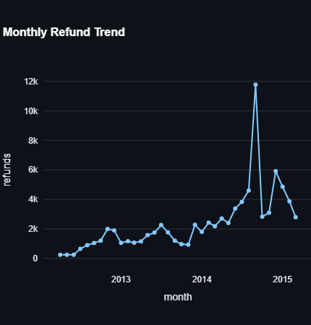
Refunds show an overall increasing trend over the period, with noticeable fluctuations.
Refund values gradually increased during 2013–2014, indicating growing refund activity.
A sharp spike in refunds occurred around late 2014, reaching approximately $11.8K, the highest point in the period.
The spike suggests a potential issue such as product quality, customer dissatisfaction, order issues, or changes in return/refund policies.
Business implication: The company should investigate the cause of the peak refund period and identify products or customer segments contributing most to refunds.

Slide 10
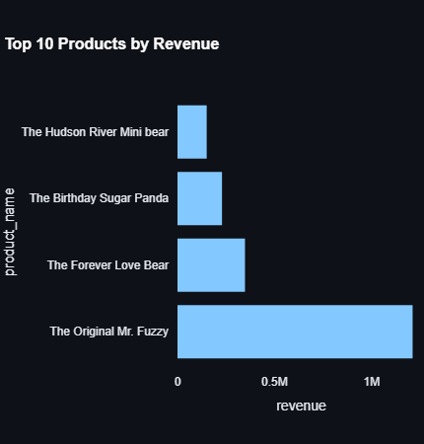
The Original Mr. Fuzzy is the clear top-performing product, generating more than $1M in revenue.
The Forever Love Bear ranks second, with revenue of approximately $350K.
The Birthday Sugar Panda and The Hudson River Mini Bear generate comparatively lower revenue.
There is a large revenue gap between The Original Mr. Fuzzy and the other products, showing strong dependence on the best-selling product.
Business implication: The company should analyze why The Original Mr. Fuzzy performs exceptionally well and use its successful pricing, marketing, and product strategy to improve other products.

Slide 11
DIAGNOSTIC ANALYSIS
Revenue Decline/Growth Analysis:- Identify the reasons behind increases or decreases in revenue by comparing orders, customers, products, marketing channels, and time periods.
Conversion Drop Analysis:- Determine why website traffic is not converting into orders by comparing sessions, pageviews, users, devices, and purchasing behaviour.
Marketing Performance Analysis:- Determine why certain marketing sources/campaigns generate more orders or revenue than others by comparing sessions, orders, revenue, and conversion rates.
Website Engagement Analysis:- Investigate why some website pages receive high or low engagement by analyzing pageviews, session behaviour, page URLs, and customer journeys.
Product Performance Analysis:- Determine why some products perform better than others by comparing quantity sold, revenue, COGS, profit, and customer demand.
Refund Cause Analysis:- Identify why certain products or periods have higher refund amounts by analyzing refunded products, order items, sales volume, and refund trends.

Slide 12
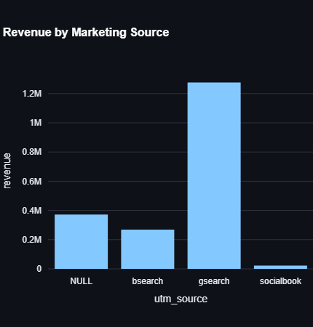
gsearch is the strongest marketing source, generating approximately $1.25M in revenue.
NULL/Unattributed traffic contributes around $370K, indicating a significant amount of revenue from sources that are not properly tracked.
bsearch generates approximately $270K, making it the third-largest contributor.
socialbook contributes very little revenue compared with the other sources.
Business implication: The company should continue investing in gsearch, while improving source tracking for NULL traffic and evaluating the effectiveness of social media marketing.

Slide 13
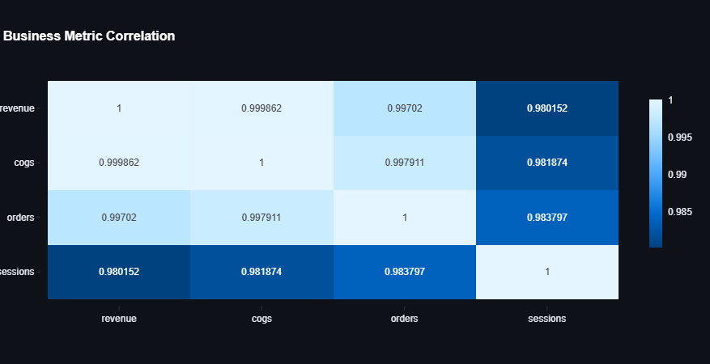
Shows the relationship between key business metrics.
Identifies strong and weak relationships among metrics.
Helps understand how website traffic, customers, orders, revenue, and refunds are connected.
Supports stakeholders in identifying business drivers and growth opportunities.
Correlation indicates association, not causation

Slide 14
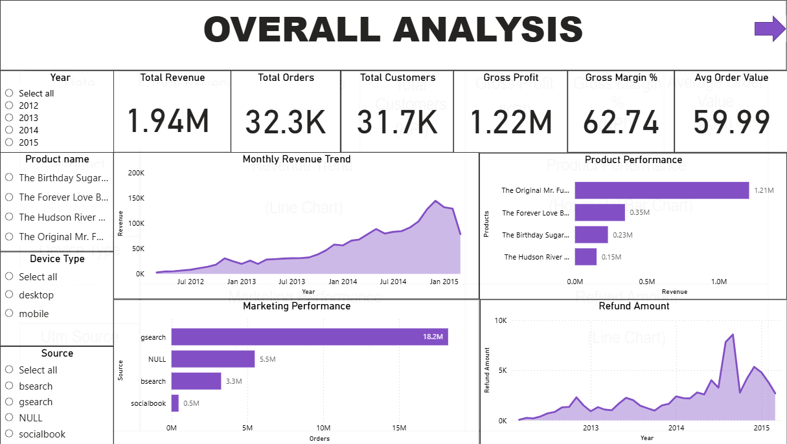
Total Revenue
Total Orders
Total Customers
Gross Profit
Gross Margin %
AOV
Revenue trend
Product performance
Marketing performance
Refund amount
Logo
CEO EXECUTIVE DASHBOARD
Date
Total Revenue
Total Orders
Total Customers
Gross Profit
Gross Margin %
Average Order Value
(Slicer)
(KPI)
(KPI)
(KPI)
(KPI)
(KPI)
(KPI)
Product
Revenue Trend
Product Performance
(Slicer)
(Line Chart)
(Horizontal Bar Chart)
Device Type
(Slicer)
Marketing Performance
Refund Amount
Utm Source
(Clustered Bar Chart)
(Line Chart)
(Slicer)

Slide 15
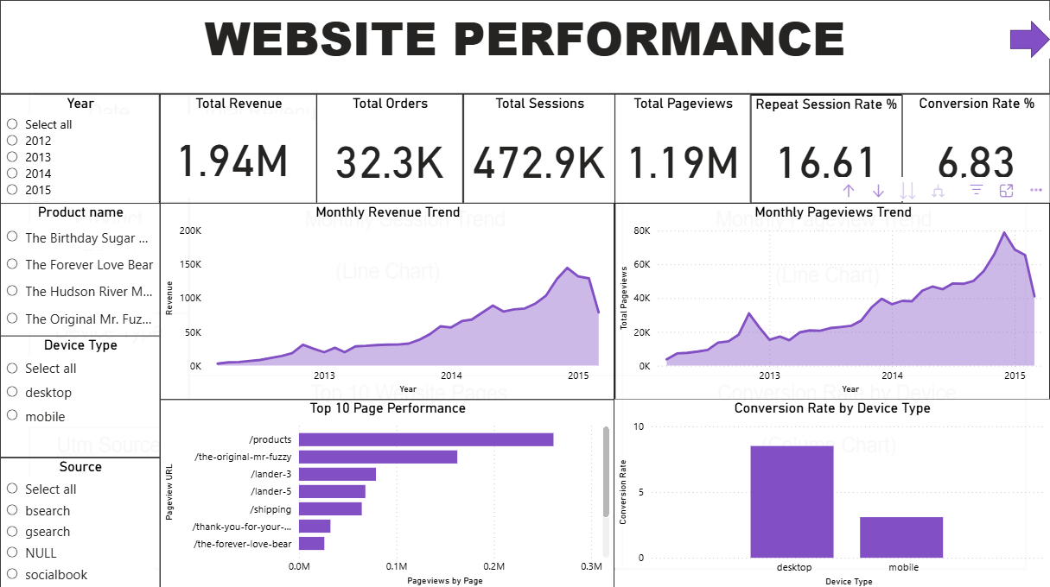
V
Logo
WEBSITE MANAGER DASHBOARD
Date
Total Revenue
Total Orders
Sessions
Pageviews
Repeat Rate %
Conversion Rate %
(Slicer)
(KPI)
(KPI)
(KPI)
(KPI)
(KPI)
(KPI)
Product
Monthly Session Trend
Monthly Pageview Trend
(Slicer)
(Line Chart)
(Line Chart)
Device Type
(Slicer)
Top 10 Website Pages
Conversion Rate by Device
Utm Source
(Bar Chart)
(Column Chart)
(Slicer)

Slide 16
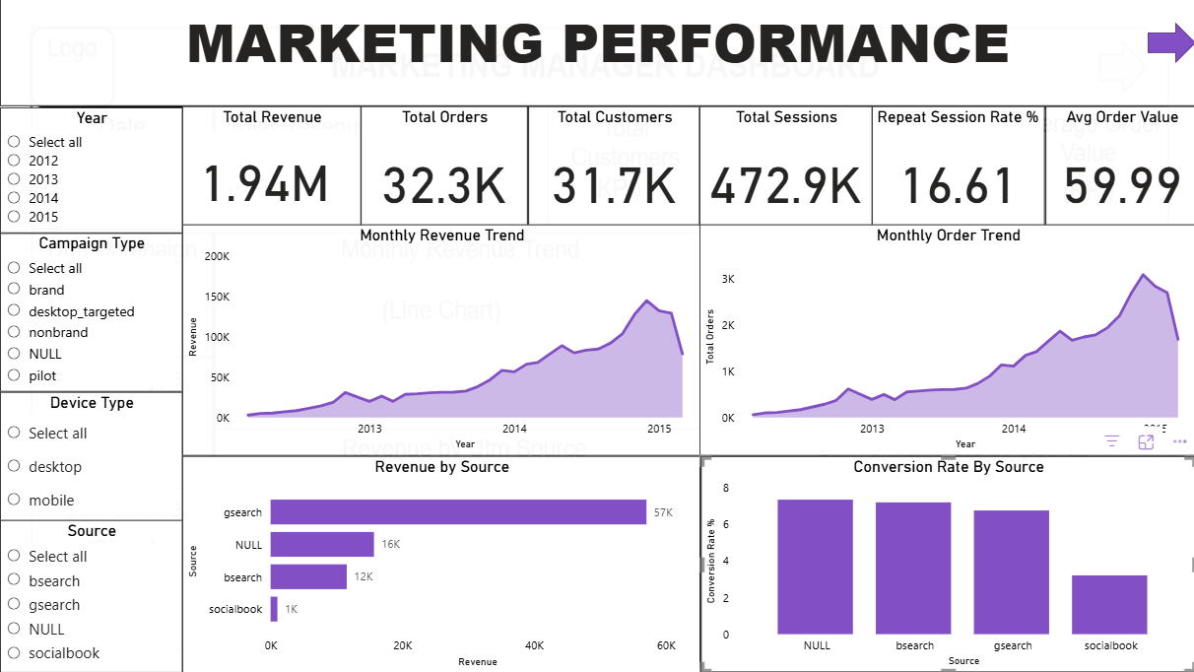
Logo
MARKETING MANAGER DASHBOARD
Date
Total Revenue
Total Orders
Total Customers
Sessions
Repeat %
Average Order Value
(Slicer)
(KPI)
(KPI)
(KPI)
(KPI)
(KPI)
(KPI)
Utm Campaign
Monthly Revenue Trend
Monthly Orders Trend
(Slicer)
(Line Chart)
(Line Chart)
Device Type
(Slicer)
Revenue by Utm Source
Conversion Rate by Source
Utm Source
(Bar Chart)
(Column Chart)
(Slicer)

Slide 17
ANALYSIS USING PYTHON
Data Loading & Data Understanding
Data Cleaning:- Handle missing values, Standardize categorical values, Check invalid numerical values, Create appropriate data types
Sales and Revenue Analysis:- Revenue Trend, Order Trend, AOV, Gross Profit, Gross Margin
Website Performance Analysis:- Session, Pageviews, Conversion
Marketing Analysis:- Sessions by source, Sessions by campaign, Orders by source , Revenue by source , Conversion rate by source , Repeat sessions by source
Refund Analysis:- Total refunds, Refund amount, Refund rate, Product-wise refunds, Refund trends, Products with unusually high refunds
Statistical Analysis: Correlation Analysis, Distribution Analysis

Slide 18
WEB USING STREAMLIT
Provides an interactive and user-friendly dashboard for business analysis.
Displays important KPIs, charts, trends, and business insights in a single platform.
Allows users to interact with data using filters and selection options.
Integrates the machine learning model to generate predictions and analytical insights.
Provides a centralized interface for business users and stakeholders to support data-driven decision-making.
USERNAME = "PankajKumar“
PASSWORD = "harshydv“
LINK: https://e---commerce-analysis-project-bomf5uh38asvww5xczprkx.streamlit.app/

Slide 19
INSIGHTS
Business Performance → Revenue & Sales
Profitability → Revenue vs COGS
Products → Top/Bottom Products
New Products → Launch Performance
Website → Sessions → Orders
Marketing → Source & Campaign Performance
Website UX → Device Performance
Revenue Leakage → Refunds
Future Growth → Revenue Forecast
Customers → Repeat & Valuable Customers

Slide 20
RECOMMENDATIONS
Increase investment in high-performing marketing sources and campaigns that generate higher orders, conversion rates, and revenue.
Prioritize high-performing products with strong revenue and gross profit, and give them greater visibility through promotions and website placement.
Investigate and improve underperforming products through pricing adjustments, promotions, better product descriptions, or product replacement.
Improve website conversion by identifying high-traffic pages and customer journeys where visitors are not converting into orders.
Optimize the mobile website experience if mobile users show lower conversion or engagement compared with desktop users.
Develop loyalty programs and personalized offers to increase repeat visits, repeat purchases, and customer retention.

Slide 21
CONCLUSION
The analysis provides a 360-degree view of the e-commerce business, covering sales, customers, website performance, marketing, products, and refunds.
The dashboards enable stakeholders to track important KPIs regularly and identify changes in business performance.
Revenue, orders, gross profit, and AOV help the CEO understand the company's overall financial and growth performance.
Website analysis helps identify traffic, engagement, device performance, and conversion opportunities.
Marketing analysis helps identify the most effective sources, campaigns, and content for generating orders and revenue.
Product analysis identifies high-performing, underperforming, and new products, supporting better product and investment decisions.
Refund analysis highlights products and periods that may negatively impact net revenue and profitability.

Slide 22
THANKS

